Slide 1
Item Characteristic Curves for Dichotomously Scored Items: 1PL/2PL/3Pl Models
Derek Briggs
EDUC 8720

Slide 2
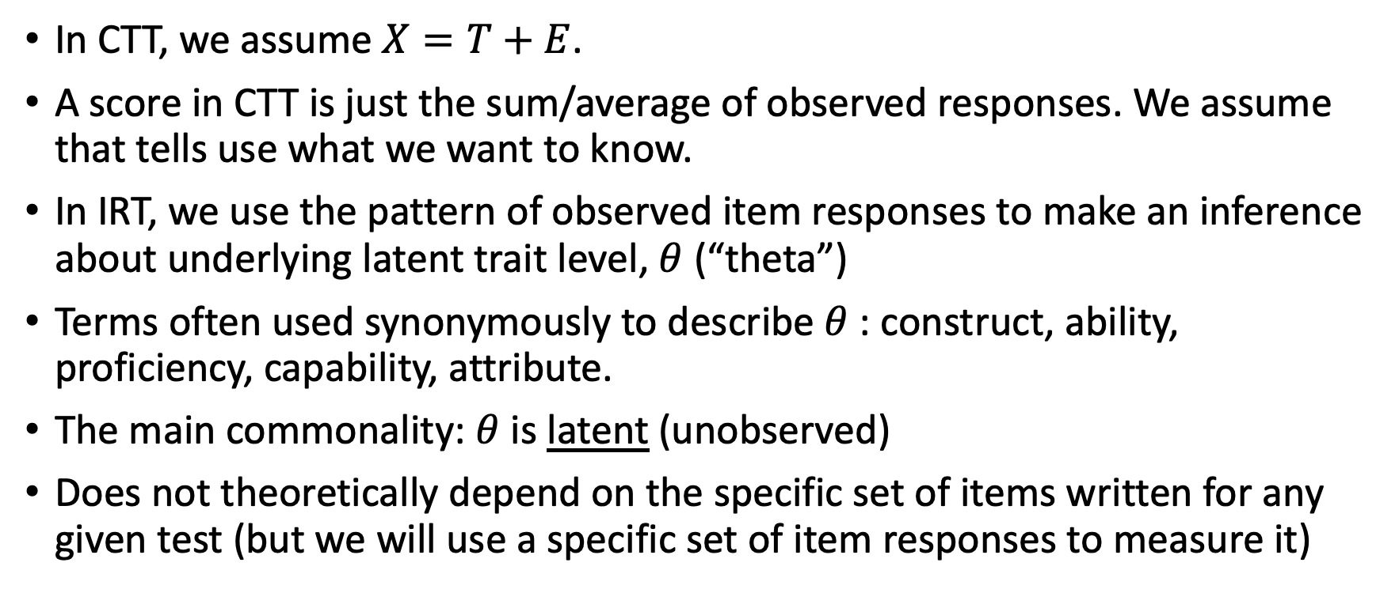
Scores in CTT vs. IRT
In CTT, we assume $X=T+E$.
A score in CTT is just the sum/average of observed responses. We assume that tells use what we want to know.
In IRT, we use the pattern of observed item responses to make an inference about underlying latent trait level, $θ$ (“theta”)
Terms often used synonymously to describe $θ$: construct, ability, proficiency, capability, attribute.
The main commonality: $θ$ is latent (unobserved)
Does not theoretically depend on the specific set of items written for any given test (but we will use a specific set of item responses to measure it)

Slide 3
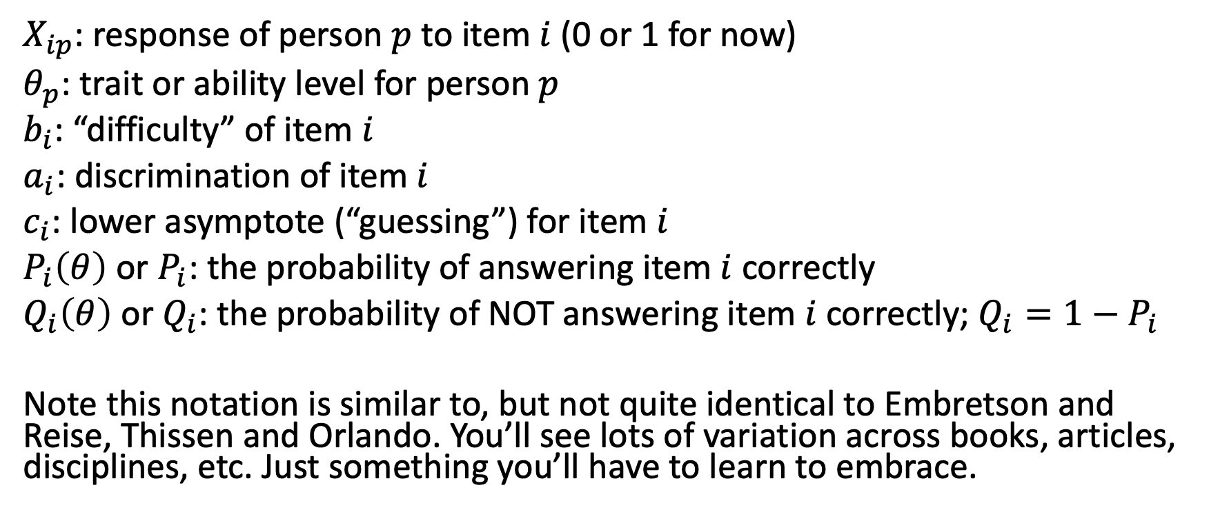
Some Notation
$X_{ip}$: response of person $p$ to item $i$ (0 or 1 for now)
$θ_{p}$: trait or ability level for person $p$
$b_{i}$: “difficulty” of item $i$
$a_{i}$: discrimination of item $i$
$c_{i}$: lower asymptote (“guessing”) for item $i$
$P_{i}\left(θ\right)$ or $P_{i}$: the probability of answering item $i$ correctly
$Q_{i}\left(θ\right)$ or $Q_{i}$: the probability of NOT answering item $i$ correctly; $Q_{i}=1−P_{i}$
Note this notation is similar to, but not quite identical to Embretson and Reise, Thissen and Orlando. You’ll see lots of variation across books, articles, disciplines, etc. Just something you’ll have to learn to embrace.

Slide 4
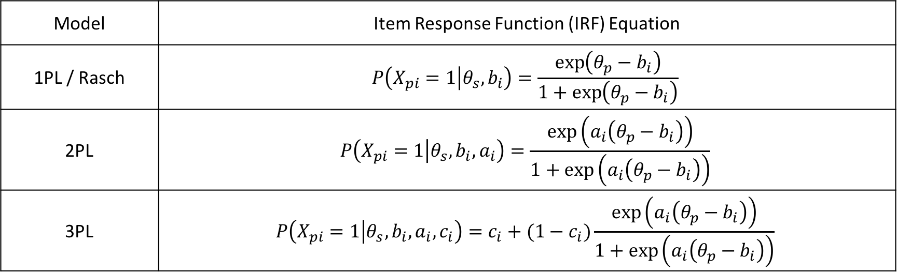
The one, two, and three-parameter logistic IRT models (aka, 1/2/3PL models)
Model | Item Response Function (IRF) Equation
1PL / Rasch | $$P\left(X_{pi}=1 | θ_{s}, b_{i}\right)=\frac{\exp\left(θ_{p}−b_{i}\right)}{1+\exp\left(θ_{p}−b_{i}\right)}$$
2PL | $$P\left(X_{pi}=1 | θ_{s}, b_{i},a_{i}\right)=\frac{\exp\left(a_{i}\left(θ_{p}−b_{i}\right)\right)}{1+\exp\left(a_{i}\left(θ_{p}−b_{i}\right)\right)}$$
3PL | $$P\left(X_{pi}=1 | θ_{s}, b_{i},a_{i},c_{i}\right)=c_{i}+(1−c_{i})\frac{\exp\left(a_{i}\left(θ_{p}−b_{i}\right)\right)}{1+\exp\left(a_{i}\left(θ_{p}−b_{i}\right)\right)}$$
These IRFs, also know as Item characteristic curves (ICCs), describe the probability of answering each item correctly, as a function of some item parameters and a person parameter.

Slide 5
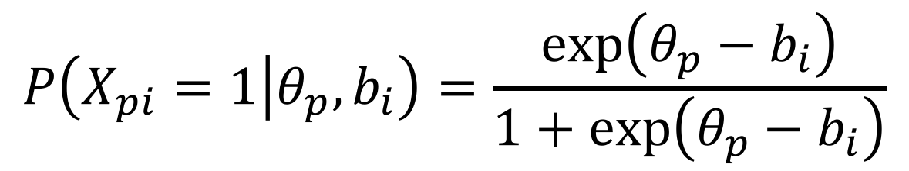
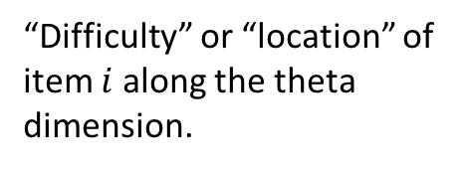
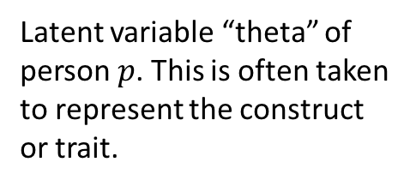
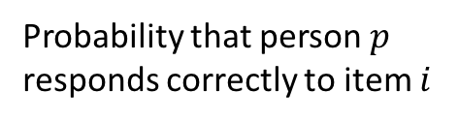
The 1PL Model Item Characteristic Curve
This is the logistic function. This describes the shape of the item response function.
Probability that person $p$ responds correctly to item $i$
$$P\left(X_{pi}=1 | θ_{p}, b_{i}\right)=\frac{\exp\left(θ_{p}−b_{i}\right)}{1+\exp\left(θ_{p}−b_{i}\right)}$$
Latent variable “theta” of person $p$. This is often taken to represent the construct or trait.
Taken together, the ICC describes how the probability of a correct (or higher) response varies as a function of the person’s location on the latent variable scale and the item’s location on the latent variable scale.
“Difficulty” or “location” of item $i$ along the theta dimension.

Slide 6
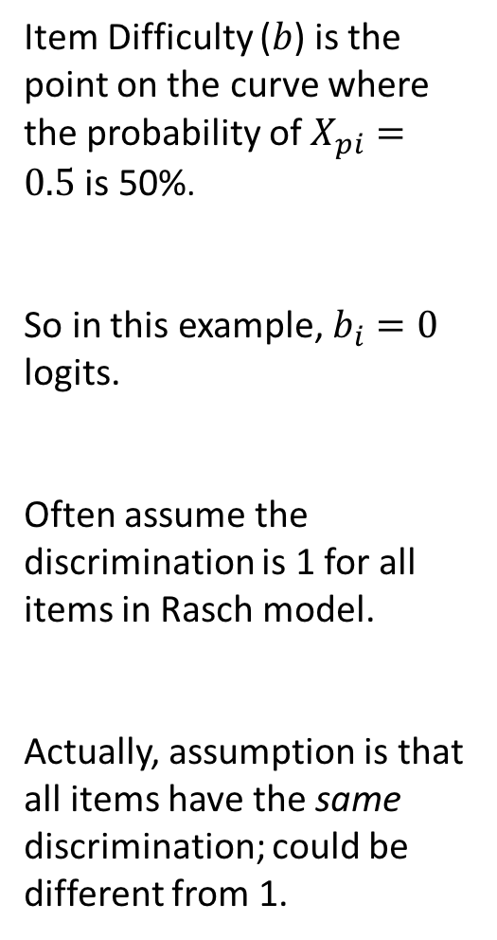

1.0
Rasch/1PL ICC
$$P\left(X_{pi}=1 | θ_{p}, b_{i}\right)=\frac{\exp\left(θ_{p}−b_{i}\right)}{1+\exp\left(θ_{p}−b_{i}\right)}$$
Item Difficulty ($b$) is the point on the curve where the probability of $X_{pi}=0.5$ is 50%.
So in this example, $b_{i}=0$ logits.
Often assume the discrimination is 1 for all items in Rasch model.
Actually, assumption is that all items have the same discrimination; could be different from 1.
0.8
0.6
Probability (X_{pi} = 1)
0.4
0.2
0.0
-3
-2
-1
0
1
2
3
Theta (in logits)

Slide 7
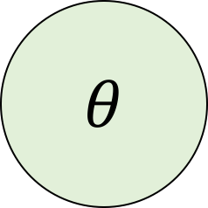

IRT as a “Factor Diagram”
Item 1
Item 2
Item 3
Item 2
Item 3
$$θ$$
Each person has a $θ$ value. Each item has a $b_{i}$ value. These two values determine the probability of a correct response to each item for each person. Based on those probabilities, we then observe either 0 or 1 for each item. You can think of this like a common factor model, but with the ICC instead of a continuous observed item score.

Slide 8
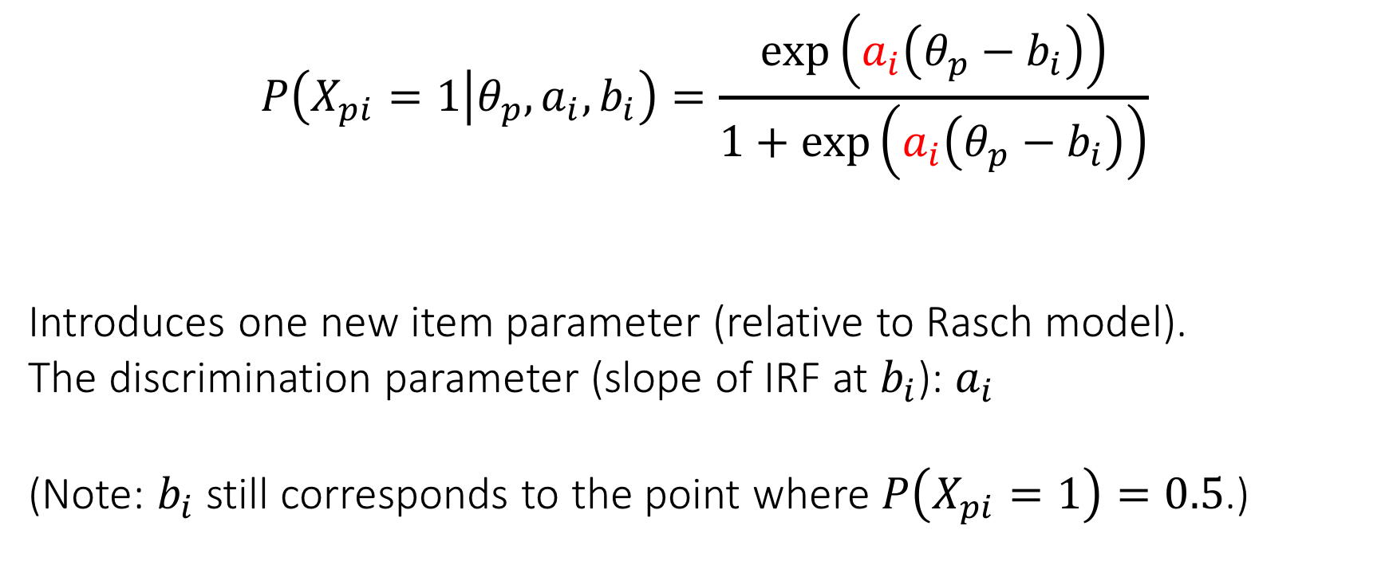
The 2PL Model
$$P\left(X_{pi}=1 | θ_{p}, a_{i}, b_{i}\right)=\frac{\exp\left(a_{i}\left(θ_{p}−b_{i}\right)\right)}{1+\exp\left(a_{i}\left(θ_{p}−b_{i}\right)\right)}$$
Introduces one new item parameter (relative to Rasch model).
The discrimination parameter (slope of IRF at $b_{i}$): $a_{i}$
(Note: $b_{i}$ still corresponds to the point where $P\left(X_{pi}=1\right)=0.5$.)

Slide 9
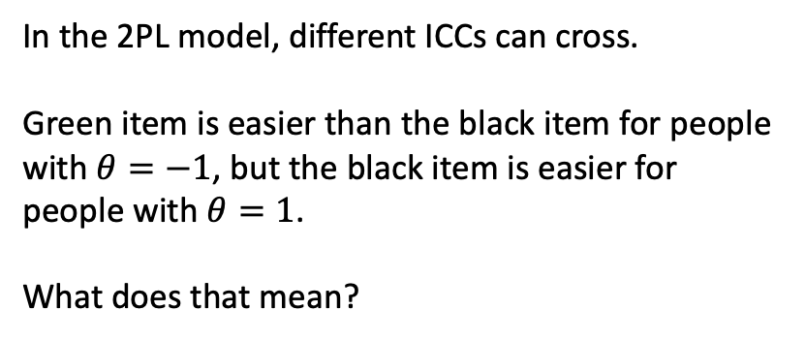
2PL IRFs
In the 2PL model, different ICCs can cross.
Green item is easier than the black item for people with $θ=−1$, but the black item is easier for people with $θ=1$.
What does that mean?

Slide 10
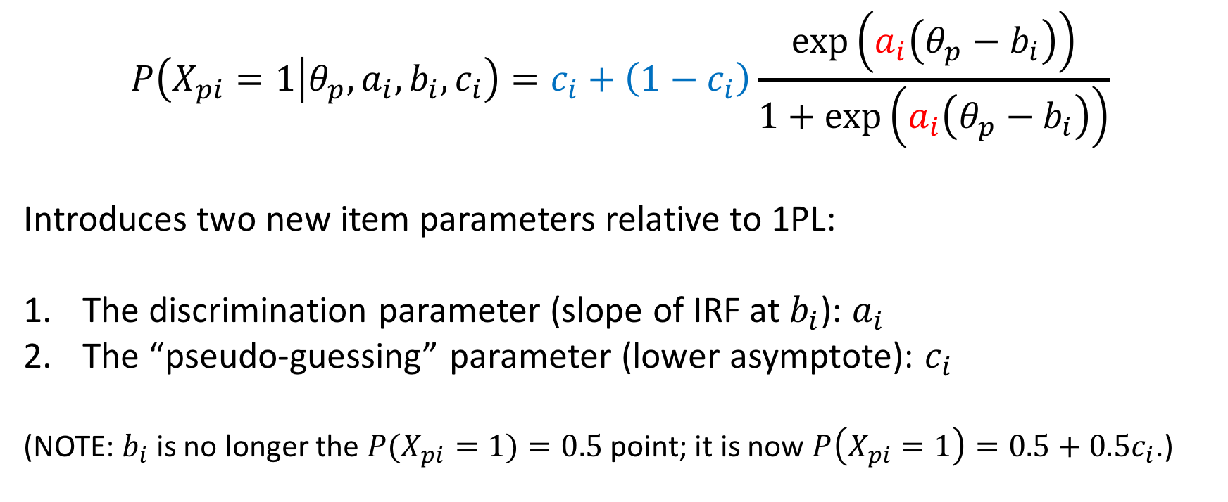
The 3PL Model
$$P\left(X_{pi}=1 | θ_{p}, a_{i}, b_{i}, c_{i}\right)=c_{i}+\left(1−c_{i}\right)\frac{\exp\left(a_{i}\left(θ_{p}−b_{i}\right)\right)}{1+\exp\left(a_{i}\left(θ_{p}−b_{i}\right)\right)}$$
Introduces two new item parameters relative to 1PL:
The discrimination parameter (slope of IRF at $b_{i}$): $a_{i}$
The “pseudo-guessing” parameter (lower asymptote): $c_{i}$
(NOTE: $b_{i}$ is no longer the $P(X_{pi}=1)=0.5$ point; it is now $P\left(X_{pi}=1\right)=0.5+0.5c_{i}$.)
Notes:
Slope is maximal at b.

Slide 11
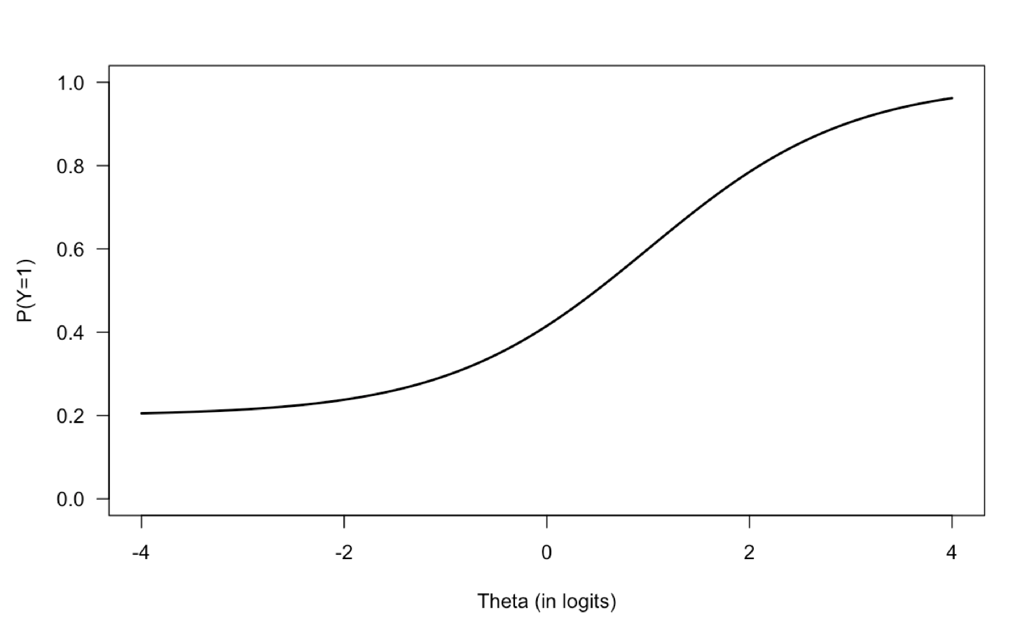
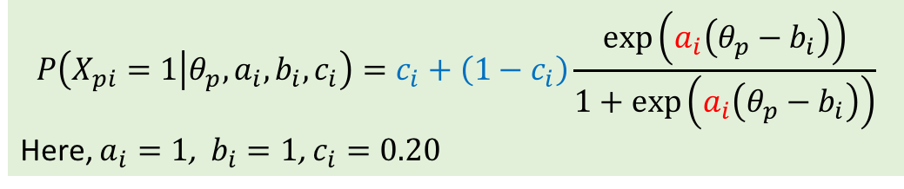
The 3PL IRF
$$P\left(X_{pi}=1 | θ_{p}, a_{i}, b_{i}, c_{i}\right)=c_{i}+\left(1−c_{i}\right)\frac{\exp\left(a_{i}\left(θ_{p}−b_{i}\right)\right)}{1+\exp\left(a_{i}\left(θ_{p}−b_{i}\right)\right)}$$
Here, $a_{i}=1$, $b_{i}=1$, $c_{i}=0.20$
Item discrimination (slope)
Item “Location”
Pseudo-Guessing Parameter

Slide 12
Comparing the IRFs
1PL/Rasch IRFs
2PL IRFs
3PL IRFs

Slide 13
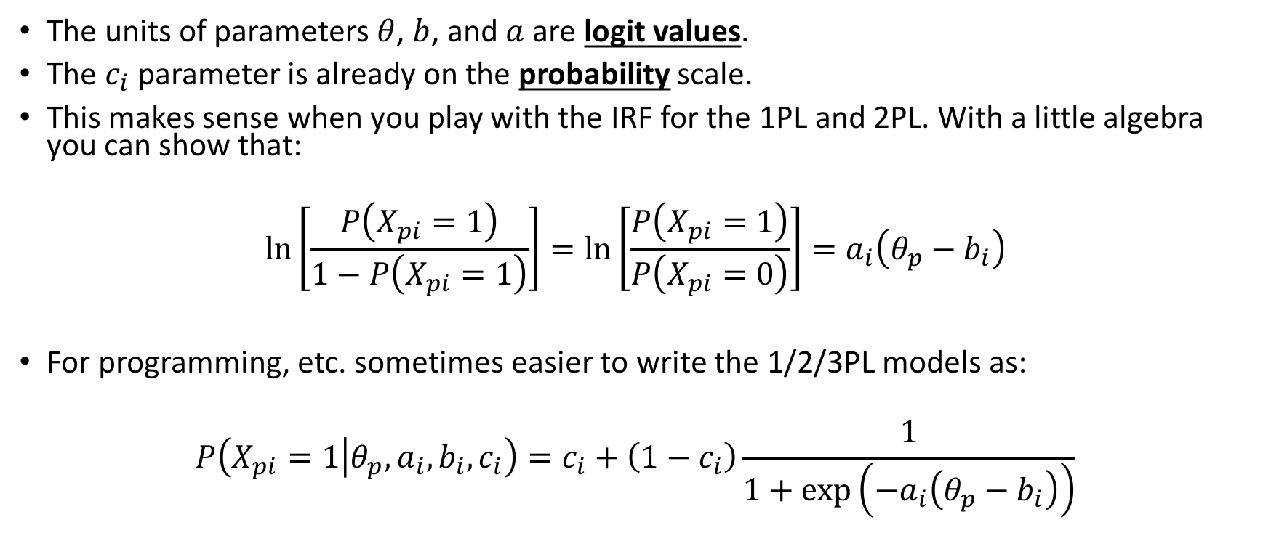
Logits and Other Forms
The units of parameters $θ$, $b$, and $a$ are logit values.
The $c_{i}$ parameter is already on the probability scale.
This makes sense when you play with the IRF for the 1PL and 2PL. With a little algebra you can show that:
$$\ln\left[\frac{P\left(X_{pi}=1\right)}{1−P\left(X_{pi}=1\right)}\right]=\ln\left[\frac{P\left(X_{pi}=1\right)}{P\left(X_{pi}=0\right)}\right]=a_{i}\left(θ_{p}−b_{i}\right)$$
For programming, etc. sometimes easier to write the 1/2/3PL models as:
$$P\left(X_{pi}=1 | θ_{p}, a_{i}, b_{i}, c_{i}\right)=c_{i}+\left(1−c_{i}\right)\frac{1}{1+\exp\left(−a_{i}\left(θ_{p}−b_{i}\right)\right)}$$

Slide 14
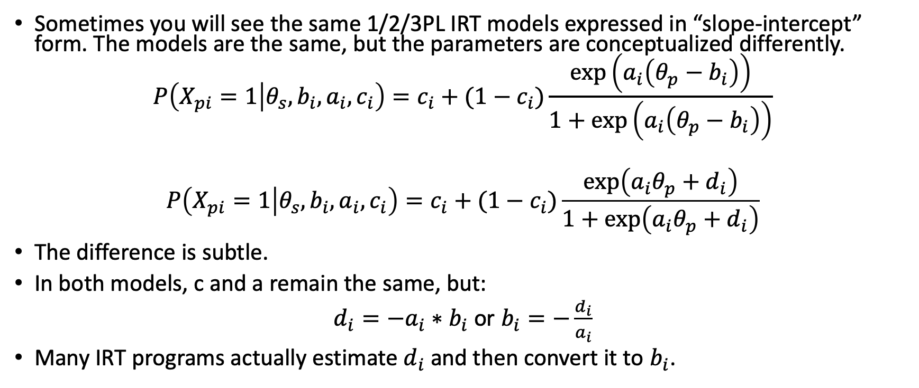
The “Slope-Intercept” Form
Sometimes you will see the same 1/2/3PL IRT models expressed in “slope-intercept” form. The models are the same, but the parameters are conceptualized differently.
$$P\left(X_{pi}=1 | θ_{s}, b_{i},a_{i},c_{i}\right)=c_{i}+(1−c_{i})\frac{\exp\left(a_{i}\left(θ_{p}−b_{i}\right)\right)}{1+\exp\left(a_{i}\left(θ_{p}−b_{i}\right)\right)}$$
$$P\left(X_{pi}=1 | θ_{s}, b_{i},a_{i},c_{i}\right)=c_{i}+(1−c_{i})\frac{\exp\left(a_{i}θ_{p}+d_{i}\right)}{1+\exp\left(a_{i}θ_{p}+d_{i}\right)}$$
The difference is subtle.
In both models, c and a remain the same, but:
$d_{i}=−a_{i}∗b_{i}$ or $b_{i}=−\frac{d_{i}}{a_{i}}$
Many IRT programs actually estimate $d_{i}$ and then convert it to $b_{i}$.

Slide 15
Practice

Slide 16
Practice with ICCs and Probabilities
item | a | b | c
1 | 1 | -1.5 | 0.2
2 | 1 | 0 | 0.2
3 | 2 | 0 | 0.3
Refer to Excel document “three_item_test.xlsx”.
Do the following:
Compare the difficulty of item 1 vs. 2.
Compare the difficulty of item 2 vs 3.
Calculate the probability of each of these response vectors for the given theta values:
Theta | 000 | 010 | 111
-4.0
-1.1
0
1.6

Slide 17
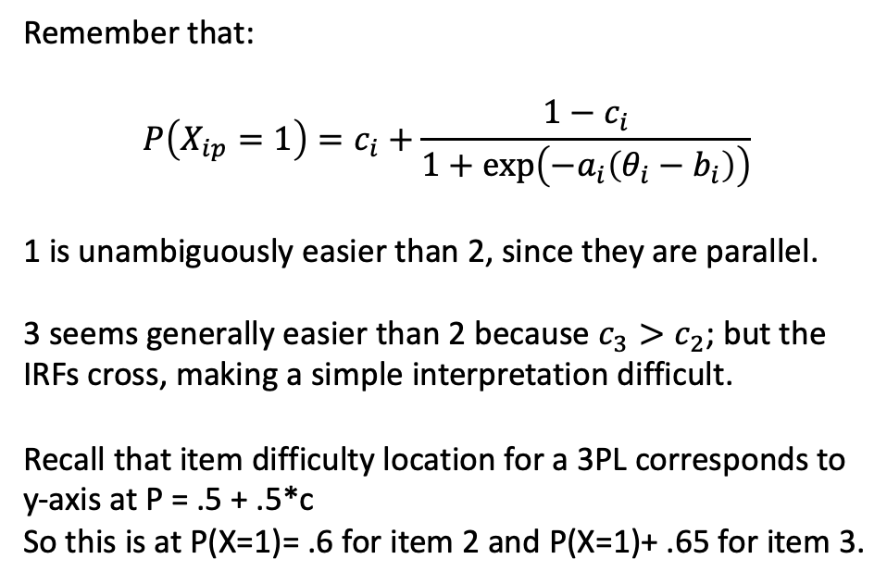
Theta | 000 | 010 | 111
-4.0 | 0.406 | 0.111 | 0.017
-1.1 | 0.126 | 0.084 | 0.095
0 | 0.024 | 0.037 | 0.298
1.6 | 0.000 | 0.001 | 0.802
Remember that:
$$P\left(X_{ip}=1\right)=c_{i}+\frac{1−c_{i}}{1+\exp\left(−a_{i}\left(θ_{i}−b_{i}\right)\right)}$$
1 is unambiguously easier than 2, since they are parallel.
3 seems generally easier than 2 because $c_{3}>c_{2}$; but the IRFs cross, making a simple interpretation difficult.
Recall that item difficulty location for a 3PL corresponds to y-axis at P = .5 + .5*c
So this is at P(X=1)= .6 for item 2 and P(X=1)+ .65 for item 3.
item | a | b | c
1 | 1 | -1.5 | 0.2
2 | 1 | 0 | 0.2
3 | 2 | 0 | 0.3

Slide 18
Example using the mirt Package in R

Slide 19
The mirt package in R
Written by Phillip Chalmers
Incredibly flexible package
Fits pretty much all the most commonly used IRT models for both dichotomous and polytomous items
Also fits most of the multidimensional extensions of these models
Other key extensions: models for multiple “groups”, inclusion of item and person predictor variables.
I’ve created an mirt folder in Canvas that includes a lot of resources, but I would hold off on reading Chalmers (2012) in the Journal of Statistical Software until we have had readings and presentations on parameter estimation.

Slide 20
Let’s use mirt to specify and estimate the 1/2/3PL Models with our Form A Data
Use code in “Part 2” of in the file “lb_irt_012626.R”
Makes use of the mirt() package in R.

